Slide 1

WIPRO NGA Program – JAVA TELECOM NMS BATCH
Capstone Project Presentation – 23 july 2024
Project Title Here - Device Configuration Microservice
Presented by - Team A
Sabbella Lakshmi Sri Devoju Akhila
Avinash Juvvala Boss Bhandari
Avula Karthik Bhavesh patil
Manepalli Pravallika Saad Makandar
Rohit Kumar Singh
www.rpsconsulting.in

Slide 2
Development Requirements
Tools
Java Development Kit (JDK)
Maven
IDE ( Eclipse)
Git for version control
Project Structure and Libraries
Maven Project
Add dependencies for Jaxp-api and Apache HttpClient in the pom.xml

Slide 3
Dependencies
Jaxp-api for NETCONF
<dependency>
<groupId>javax.xml</groupId>
<artifactId>jaxp-api</artifactId>
<version>1.4</version>
</dependency>
Apache HttpClient for RESTCONF API interactions.
<dependency>
<groupId>org.apache.httpcomponents</groupId>
<artifactId>httpclient</artifactId>
<version>4.5.13</version>
</dependency>

Slide 4
Aim of the Project
The aim of our project is to develop a robust NETCONF client that establishes a connection with network devices and fetches configuration data using operations like <get-config>, <edit-config>, <get>, and <rpc>. Simultaneously, we aim to create a RESTCONF client that interacts with the RESTCONF API to retrieve and apply configuration data through standard HTTP methods such as PUT, GET, POST, and DELETE. Ensuring the basic functionality of these clients, we will conduct unit testing to verify that they perform the intended operations correctly.

Slide 5
How Netconf and Restconf Works?
NETCONF uses SSH and XML for secure device management, while RESTCONF uses HTTP and JSON/XML for web-based configuration, with both requiring connection setup, operations for NETCONF(<get-config>, <edit-config>, <get>, and <rpc>) and operations for RESTCONF(GET, POST, PUT, DELETE), and response validation.

Slide 6

Introduction to the NETCONF
What is NETCONF?
→ NETCONF (Network Configuration Protocol) is used for network device management.
→ It is designed to manage network devices and their configurations.
→ It operates over a secure transport layer (typically SSH) and uses XML-based messages for communication between a client and a NETCONF server
2024 - RPS Consulting all rights reserved

Slide 7
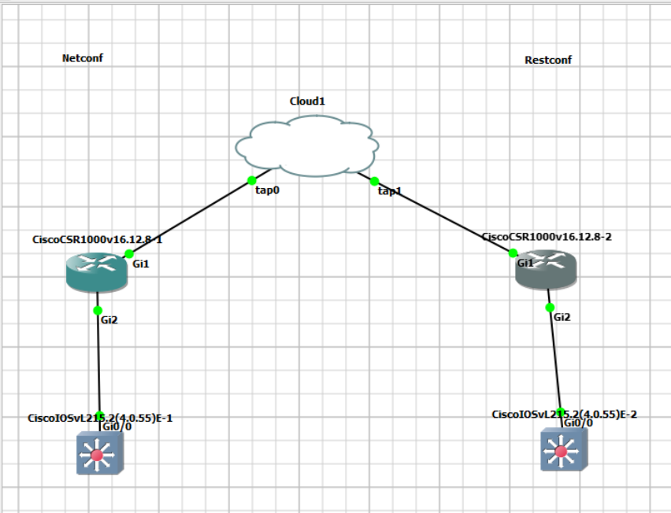
Establishing Connection to the Netconf server

Slide 8
NetconfClientManager
A class NetconfClientManager is used for interacting with a NETCONF Server.
NETCONF Protocol is used for managing the Network devices.
The class provides methods to connect to the server.
It perform <get-config>, <edit-config>,<get> and <rpc> operations and print the configuration response in a XML formatted way.

Slide 9
Connect Method and sendRpc Method
Connect Method:-Establish a Connection to the netconf server.
public void connect(String url) throws Exception {
URL serverUrl = new URL(url);
connection = (HttpURLConnection) serverUrl.openConnection();
connection.setDoOutput(true);
}
sendRpc Method :-sends the RPC Request to the Server and return the response.
private String sendRpc(String rpc) throws Exception {
Document doc = builder.parse(new InputSource(new StringReader(rpc)));
TransformerFactory tf = TransformerFactory.newInstance();
Transformer transformer = tf.newTransformer();
transformer.transform(new DOMSource(doc), new StreamResult(writer));
return writer.toString();
}

Slide 10
NETCONF Operations
<get-config>: Retrieve configuration data.
<edit-config>: Modify configuration data.
<get>: Retrieve operational data.
<rpc>: Execute remote procedure calls.

Slide 11
NETCONF TESTING
JUnit tests for NETCONF operations like getConfig, editConfig, performGetAndPrint, and performRpcAndPrint.
Each test connects to the NETCONF server at http://172.20.0.108 and closes the connection afterward.
Tests for editConfig and performRpcAndPrint verify modifying the device configuration with appropriate RPC requests and ensure responses are not null.

Slide 12
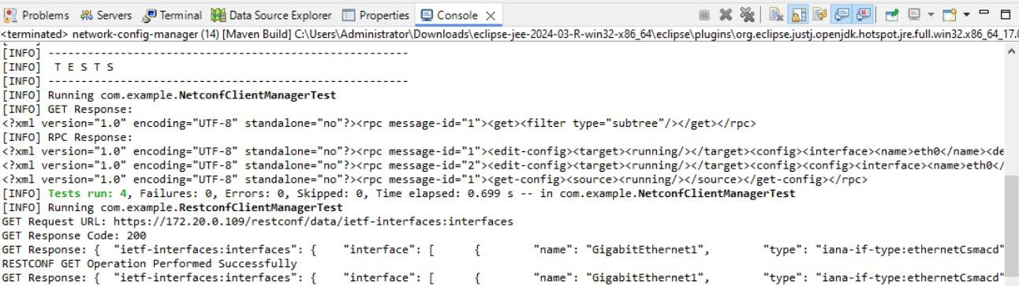
OUTPUT RESPONSES FOR THE NETCONF

Slide 13
Introduction to RESTCONF
What is RESTCONF?
→RESTCONF (Representational State Transfer Configuration Protocol) is used for network device management and configuration through a RESTful API.
→It is designed to provide a programmable interface to access and manipulate configuration data.
→Operates over HTTP/HTTPS, ensuring secure communication
→Utilizes XML for encoding configuration data.

Slide 14
Establishing Connection to the Restconf Server

Slide 15
RestconfClientManager
A class RestconfClientManager for interacting with a RESTCONF Server over HTTPS.
Restconf is a Protocol used for accessing data defined in YANG, a data modeling language for the NETCONF protocol.
It handles SSL connections, sends GET, POST, DELETE and PUT requests, and processes responses from the server.

Slide 16
Connecting to the Server using Credentials
String baseUrl = "https://172.20.0.116/restconf/data/ietf-interfaces:interfaces";
String username = "admin";
String password = "cisco123";
RestconfClientManager restconfClientManager = new RestconfClientManager(username, password);

Slide 17
RESTCONF Operations
PUT: Update or create configuration data.
GET: Retrieve configuration data.
POST: Create new configuration data.
DELETE: Remove configuration data.

Slide 18
RESTCONF TESTING
The file contains a JUnit test for RESTCONF operations, including GET, POST, DELETE and PUT requests to manage network device configurations.
The test connects to the RESTCONF server at https://172.20.0.109/restconf/data/ietf-interfaces:interfaces with provided credentials.
Each operation (GET, POST, PUT,DELETE) is performed with appropriate request bodies, and the responses are verified to ensure they are not null.

Slide 19
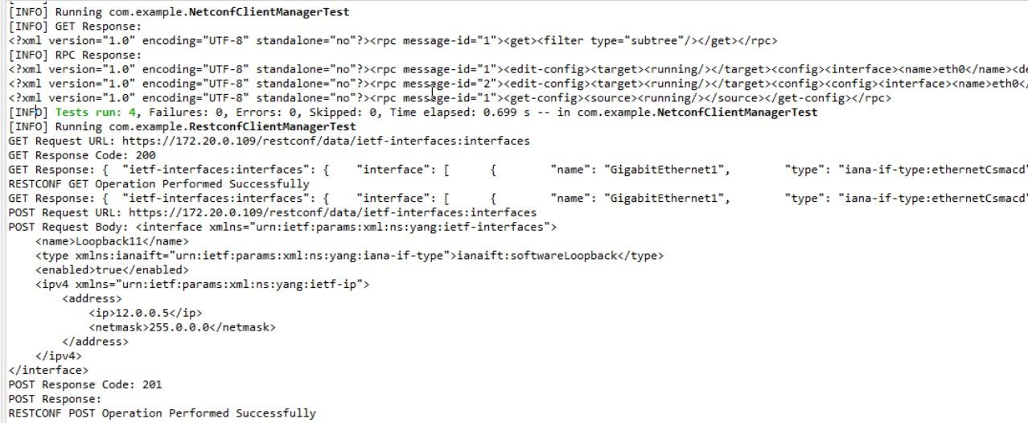
OUTPUT RESPONSES FOR THE RESTCONF

Slide 20
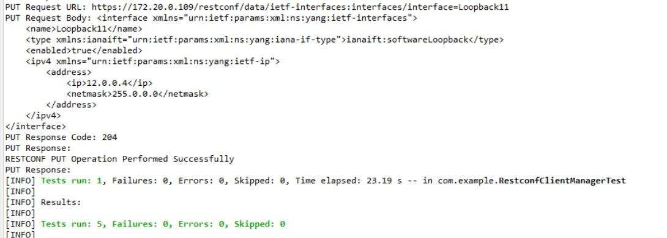
OUTPUT RESPONSES FOR THE RESTCONF(Continue..)

Slide 21
Conclusion
Our project aims to build tools for managing network configurations. We develop a NETCONF client for secure device communication using XML and a RESTCONF client for easy web-based management with HTTP. By thoroughly testing both tools, we will ensure they work correctly and efficiently for effective network management.

Slide 22
Thank you
.

